Slide 1
Legacy & Eternity
Estate Planning - Session 4
Brad & Andrea Jack, Lyle Weber © 2022

Slide 2
Giving Himself Away John Wesley
Notes:
What legacy will you leave behind?

Slide 3
Setting a finish line for your wealth
How much is enough?
Notes:
At some point, we need to ask the question, “How much is enough?” Do you have a finish line?

Slide 4
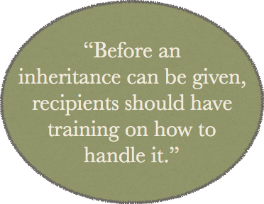
INHERITANCE PLAN FOR YOUR CHILDREN
Notes:
Many families simply leave their inheritance first to the surviving spouse and when they pass away, it is divided by their kids in equal shares. Before you pass wealth, you should be in the business of imparting wisdom.

Slide 5
Proverbs 20:21
An inheritance obtained too early in life
is not a blessing
in the end.”
Notes:
The writer of Proverbs 20:21 knew a thing or two about wealth and succession.

Slide 6
Wealth won in haste dwindles away,
but he who gathers little by little
will increase them.
Proverbs 13:11
Recommended Book
“Splitting Heirs: Giving Your Money and Things to Your Children Without
Ruining Their Lives”
by Ronald Blue
Notes:
This is a great book, if you haven’t read it. Splitting Heirs by Ronald Blue.

Slide 7
The goal for our heirs
Instilling values and
sharing the motives that brought you to the place you are now.
Notes:
It takes time spent with your family to share your values and motives.

Slide 8
Do your giving
while you’re living,
so you’re knowing
where it’s going.
Notes:
Decide now while you still have your wits about you.

Slide 9
Having the “Family Talk”
Share what you plan to do in your estate and be available to answer questions.
Let them know that you were the one who came up with your estate distribution plan.
If you change your plan later or just prior to your passing, heirs will suspect you were persuaded by someone to favor them. There will be tension at your funeral, or they may never talk for the rest of their lives.
Notes:
Do you want your family to be on good terms after you are gone? Prepare them ahead of time. The more wealth you have, the more crucial it is to have this conversation when everyone is still healthy and happy.

Slide 10
What do you want to hear at the end of your life?
Dr. Billy Graham
Notes:
What will people say about you when your time comes?

Slide 11
1 Timothy 6 Verses:17-19
Trust in God
Use money for good
Be rich in good deeds
Be generous, willing to share
A foundation for a real future

Slide 12
Bill & Vonette Bright
Founder of Campus Crusade for Christ (CRU)

Slide 13
Prayerfully consider including your local church in your estate plans. You can’t take it with you, but you can send it on ahead!
Legacy
&
Eternity
Brad & Andrea Jack, Lyle Weber © 2022
https://maximizingstewardship.net

